Slide 1
Tree Structures
Notes:
To create Em dash above headline:
Same size and weight as the headline and set using a soft return.
PC: Em dash (—): Alt+Ctrl+ - (minus)
Mac: Em dash (—): Shift+Alt/Option+hyphen

Slide 2
Agenda
Overview
Tree
Binary Search Tree
Balanced Tree
Heap
Tree and Graph Algorithms
Graph Traversal
Data Compression

Slide 3
1. Overview
Notes:
To create Em dash above headline:
Same size and weight as the headline and set using a soft return.
PC: Em dash (—): Alt+Ctrl+ - (minus)
Mac: Em dash (—): Shift+Alt/Option+hyphen

Slide 4
Learning Objectives
Understand and define various tree structures
Understand and implement various algorithms with the tree structures

Slide 5
2. Tree
Notes:
To create Em dash above headline:
Same size and weight as the headline and set using a soft return.
PC: Em dash (—): Alt+Ctrl+ - (minus)
Mac: Em dash (—): Shift+Alt/Option+hyphen

Slide 6

What is a Tree?
Suppose we need a data structure to keep track of books in a library. Can a list or an array implement this structure? Is it efficient?
Book
Text books
Math
Physics
Reference books
Dictionaries

Slide 7
What is a Tree?
An efficient structure to implement hierarchical data
A hierarchy of nodes → node: data + references (sounds familiar?)
Starts from root → expands to branches → ends at leaves

Slide 8
Terms for describing a Tree
Top node: root
The sequence of connections (arcs) between root and a node: path
number of arcs in path: path length
number of nodes in path to node x (= path length + 1): level of x
Node at the lower end of each path: leaf node
Total number of nodes: size

Slide 9
Terms for describing a Tree
A node connected directly above another node: parent
parent, parent of parent, …: predecessors
A node connected directly below another node: child
children, children of children, …: successors
Sometime, order of children matters: ordered tree
Number of nodes in the longest path from root to a leaf node: height/depth of tree
Set of all nodes connected under a certain node: subtree

Slide 10
Terms for describing a Tree
Parent may have multiple children
but child has only one parent
Root node is level 0 (sometimes 1), has no parent
Level refers to the path from the root to the node
Leaf node has no children

Slide 11
Tree Example
Book
Text book
Math
Physics
Reference book
Dictionary
Level 0
root
my parent
height = 3
Level 1
my child
Level 2
subtree
rooted at ‘Text book’
path
(Book – Reference book – Dictionary)
leaf nodes

Slide 12
2a. Binary Tree
Notes:
To create Em dash above headline:
Same size and weight as the headline and set using a soft return.
PC: Em dash (—): Alt+Ctrl+ - (minus)
Mac: Em dash (—): Shift+Alt/Option+hyphen

Slide 13
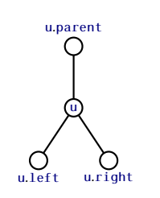
Binary Tree
Binary Tree: each node has at most 2 children.
Normally, binary trees are ordered: distinguished left-child and right-child
→ How many references a node should have?
parent
data
left | right

Slide 14
Binary Tree Traversal
Traversal is process to visit nodes in tree:
Depth First: proceed as far as possible to the left/right (recursive)
pre-order
in-order
post-order
Breadth First: proceed layer by layer, left to right (iterative)

Slide 15
Binary Tree Traversal
Visit: temporary stop at the node, do something with its data
Node can be referred to many times, but should be visited only once.
The initial reference is always root.
→ Traversal could be used to re-compute the size of the tree

Slide 16
Pre-order Traversal
At each node, visit: node → left subtree → right subtree
private void traversePreRecursive() {
System.out.print("\nPre-order traversal recursive: ");
preRecursive(root);
}
private void preRecursive(BTNode node) {
if (node != null) {
System.out.print(" " + node.data); //node visit
preRecursive(node.left);
preRecursive(node.right);
}
}
…
1
…
…
2
3
Notes:
https://stackoverflow.com/questions/9456937/when-to-use-preorder-postorder-and-inorder-binary-search-tree-traversal-strate

Slide 17
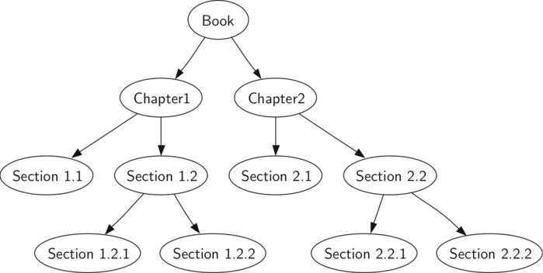
Pre-order Traversal

Slide 18
In-order Traversal
At each node, visit: left subtree → node → right subtree
private void traverseInRecursive() {
System.out.print("\nIn-order traversal recursive: ");
inRecursive(root);
}
private void inRecursive(BTNode node) {
if (node != null) {
inRecursive(node.left);
System.out.print(" " + node.data); //node visit
inRecursive(node.right);
}
}
…
2
…
…
1
3

Slide 19
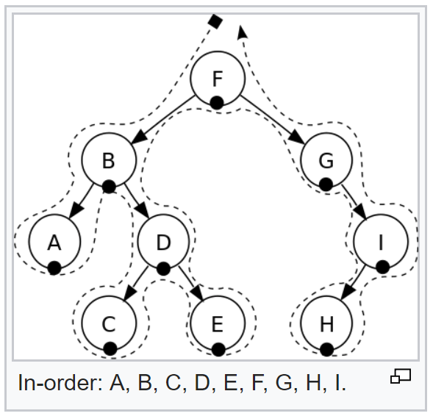
In-order Traversal
Notes:
In a binary search tree, in-order traversal retrieves data in sorted order.

Slide 20
Post-order Traversal
At each node, visit: left subtree → right subtree → node
private void traversePostRecursive() {
System.out.print("\nPost-order traversal recursive: ");
postRecursive(root);
}
private void postRecursive(BTNode node) {
if (node != null) {
postRecursive(node.left);
postRecursive(node.right);
System.out.print(" " + node.data); //visit node
}
}
…
3
…
…
1
2

Slide 21
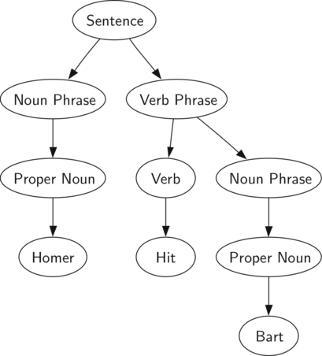
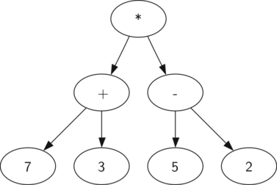
Post-order Traversal
Notes:
http://interactivepython.org/courselib/static/pythonds/Trees/ParseTree.html#lst-eval

Slide 22
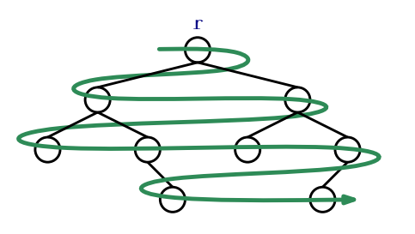
Breadth First Traversal
Start from root, visit nodes layer by layer, from left to right
private void bfTraverse() {
System.out.print("\nBreadth-first traversal iterative: ");
Queue<BNode> q = new LinkedList<BTNode>(); // java.util.LinkedList
if (root != null) q.add(root);
while (!q.isEmpty()) { // same as while (q.isEmpty() != true)
BNode node = q.remove();
System.out.print(" " + node.data); // visit node
if (node.left != null) q.add(node.left);
if (node.right != null) q.add(node.right);
}
}

Slide 23
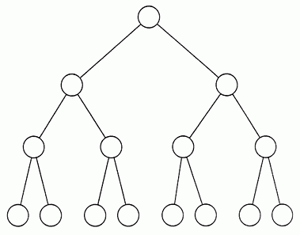
Why Binary Tree?
Start from root, it takes maximum h steps to reach an arbitrary node (h is height of the tree)
Binary tree can be configured to have h = log(tree size).
height

Slide 24
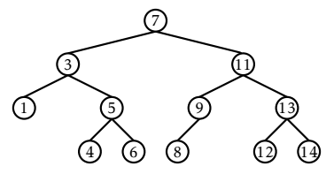
Binary Search Tree (BST)
A special kind of binary tree
Binary search tree property: at each node, key data of that node is greater than all key data in the left subtree, and is smaller than all key data in the right subtree
→ Why key data rather than just data?
Value of key data increases

Slide 25
BST – Search
The BST property is extremely useful to quickly locate a value x in the tree.
Start from the root r, at each node u, there are three cases:
If x < u.data → search u.left;
If x > u.data → search u.right;
If x == u.data → found the node u containing x.
The search terminates when Case 3 occurs, or when u == null
If u == null, x is not in the tree

Slide 26
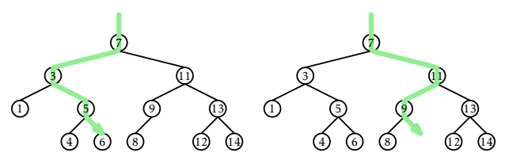
BST – Search
BTNode find(int x) { //search for node with key x
BTNode node = root;
while (node != null) {
if (x < node.data) node = node.left;
else if (x > node.data) node = node.right;
else return node;
}
return null;
}

Slide 27
BST – Insert
To maintain the BST property, each key value has to be unique
Search for the key value to be added:
Already exist → does not need to (cannot) be added
Does not exist → can be added as a child of an appropriate existing node → which node?
If key does not exist, the last visited node in the tree should become parent for the new node

Slide 28
BST – Insert
Add 10

Slide 29
BST – Insert
public boolean insert(int value) {
if (root == null) root = new BTNode(value);
else {
BTNode parent = null, current = root;
while (current != null) {
if (value < current.data) {
parent = current;
current = current.left;
}
else if (value > current.data) {
parent = current;
current = current.right;
}
else return false;
// already exists, can’t insert
}
if (value < parent.data) {
parent.left = new BTNode(value);
parent.left.parent = parent;
} else {
parent.right = new BTNode(value);
parent.right.parent = parent;
}
}
size++;
return true;
// insert successful
}

Slide 30
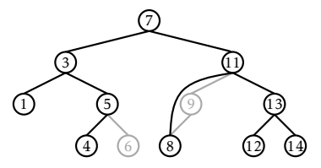
BST – Remove
First, search the key value and return the node reference
Case 1: If node is a leaf: detach node from its parent (update references!)
Case 2: If node has only one child: let that child replaces node (splice)

Slide 31
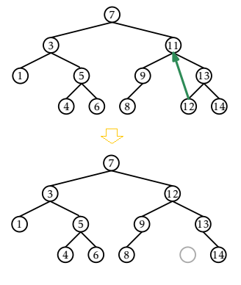
BST – Remove
Case 3: If node has two children, find a nearby node w which has less than 2 children
node with smallest data in the right subtree
or node with largest data in the left subtree
Let that node w replaces u

Slide 32
BST – Remove
public void remove(BTNode node) {
if (node.left == null || node.right == null)
splice(node);
else {
BTNode w = node.right;
while (w.left != null)
w = w.left;
node.data = w.data;
splice(w);
}
}

Slide 33
BST – Remove
private void splice(BTNode node) { //also work for leaf
BTNode s, p;
if (node.left != null) s = node.left;
else s = node.right;
if (node == root) {
root = s;
p = null;
} else {
p = node.parent;
if (p.left == node) p.left = s;
else p.right = s;
}
if (s != null) s.parent = p;
size--;
}

Slide 34
2b. Balanced Tree
Notes:
To create Em dash above headline:
Same size and weight as the headline and set using a soft return.
PC: Em dash (—): Alt+Ctrl+ - (minus)
Mac: Em dash (—): Shift+Alt/Option+hyphen

Slide 35
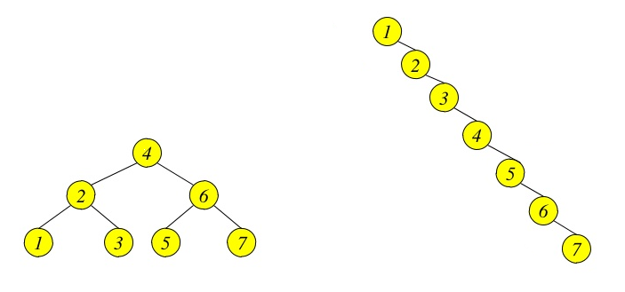
Balanced vs. Unbalanced
How fast to search for ‘7’ in the following trees?

Slide 36
Balanced vs. Unbalanced
Balanced tree: for every node in the tree, the height of its left subtree and height of its right subtree differ no more than 1.
Perfectly balanced tree: balanced, and all leaves located in two last levels
Much of complexity of operations in trees belong to the search for the node.
→ Processing the balanced trees (do not have to be perfect) are faster

Slide 37
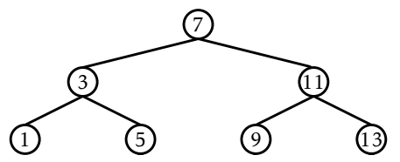
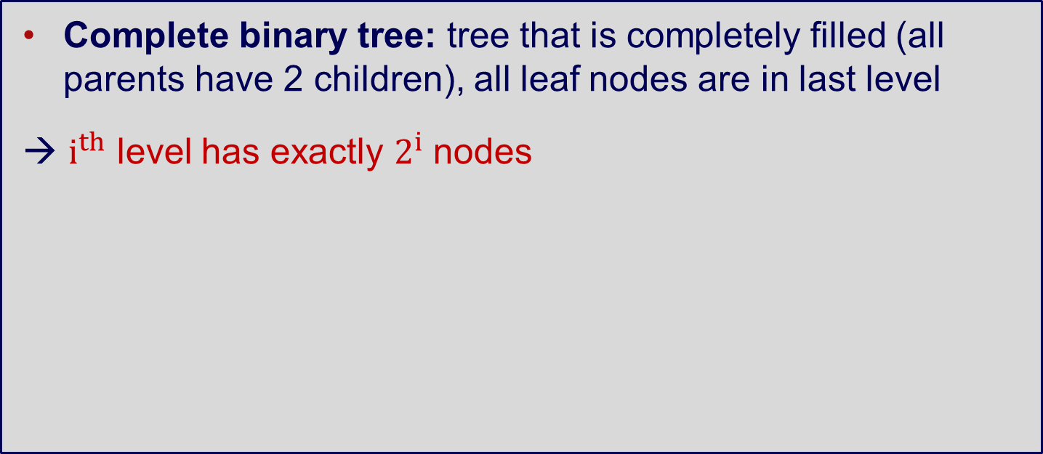
Complete Binary Tree
Complete binary tree: tree that is completely filled (all parents have 2 children), all leaf nodes are in last level
→ $i^{th}$ level has exactly $2^{i}$ nodes

Slide 38
Complete Binary Tree
Height of complete binary tree
= height of a perfectly balanced tree
= log(size)
→ Maximum log(size) steps to reach arbitrary node!

Slide 39
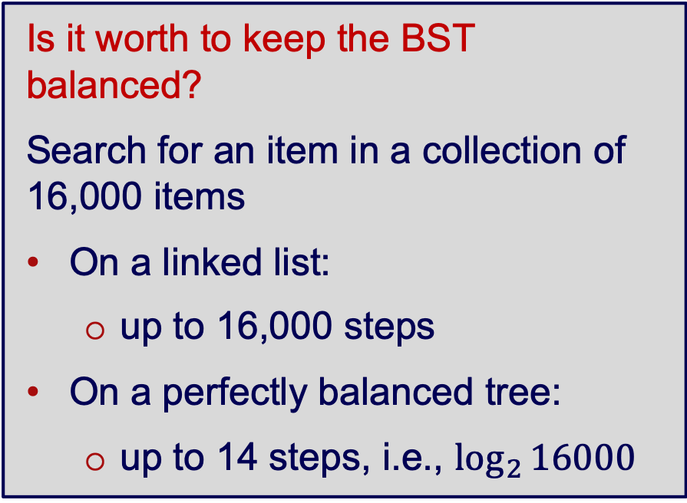
Complete Binary Tree
Is it worth to keep the BST balanced?
Search for an item in a collection of 16,000 items
On a linked list:
up to 16,000 steps
On a perfectly balanced tree:
up to 14 steps, i.e., $\log_{2}{16000}$
Height | Nodes at one level | Nodes at all levels
1 | 2⁰ = 1 | 1
2 | 2¹ = 2 | 3
3 | 2² = 4 | 7
…
11 | 2¹⁰ = 1,024 | 2,047
…
14 | 2¹³ = 8,192 | 16,383

Slide 40
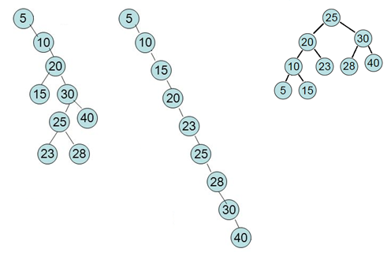
Day–Stout–Warren Algorithm
Create a perfectly balanced BST from an arbitrary BST:
Transform initial tree into backbone (linked list like tree)
Transform the backbone into perfectly balanced tree
→ The core algorithm: tree rotation
→ Time complexity: O(n)

Slide 41
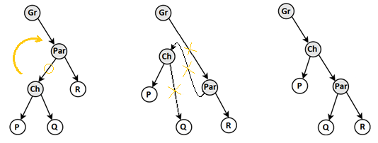
DSW Algorithm – Tree Rotation
Rotation subtree
Right rotation:
if Par has left child Ch
Ch replace position of Par,
Par become right child of Ch
right child of Ch becomes left child of Par
Left rotation:
does the reversed process
Right rotation about Par (R, P, Q can be subtrees)

Slide 42
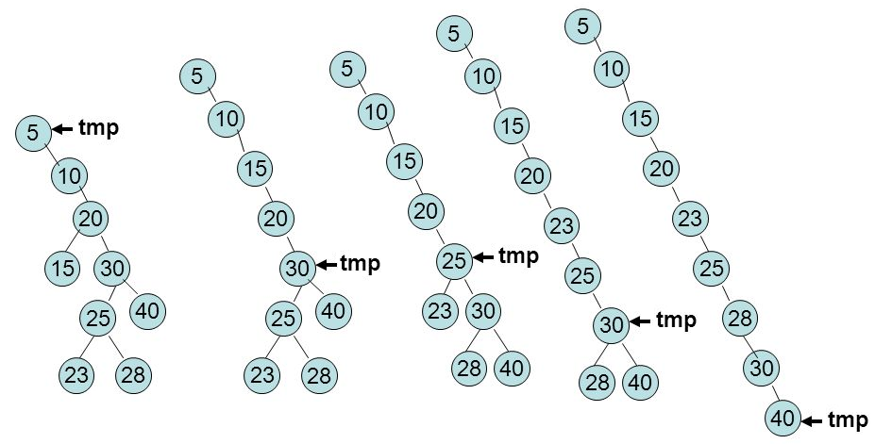
DSW Algorithm – Backbone
Transform unbalanced tree to backbone tree
tmp = root;
while (tmp != null):
if tmp has left child
right rotate at tmp
tmp = tmp.parent
else tmp = tmp.right
After right rotated abound ‘20’
After right rotated abound ‘30’
After right rotated abound ‘25’
After right rotated abound ‘30’

Slide 43
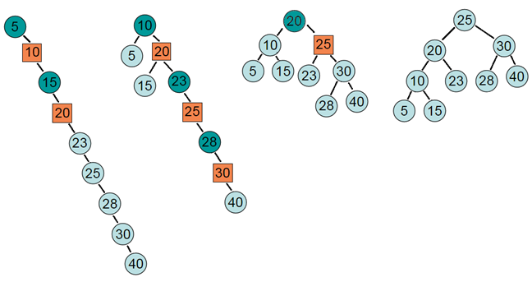
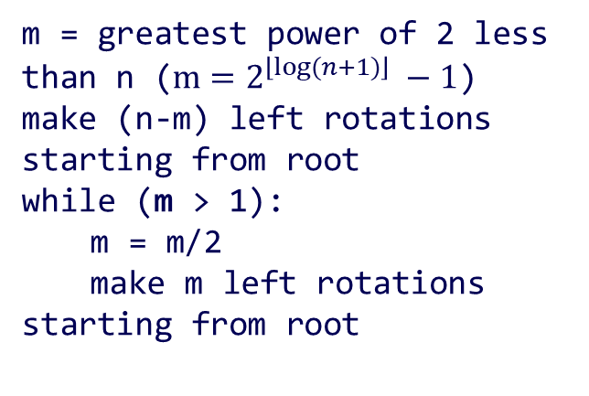
DSW Algorithm – Backbone
Transform backbone tree to perfectly balanced tree
m = greatest power of 2 less than n ($m=2^{\left\lfloor log⁡(n+1)\right\rfloor } −1$)
make (n-m) left rotations starting from root
while (m > 1):
m = m/2
make m left rotations starting from root
(m = 7)
(n – m =2)
After left rotated abound ‘5’ and ‘15’
(m/2 = 3)
After left rotated abound ’10’, ‘23’ and ‘28’
(m/2 = 1)
After left rotated abound ’20’
Notes:
expected node on the bottom level = log(n) – 1 = log(9) – 1 = 3.1699250014423126 – 1 = 2

Slide 44
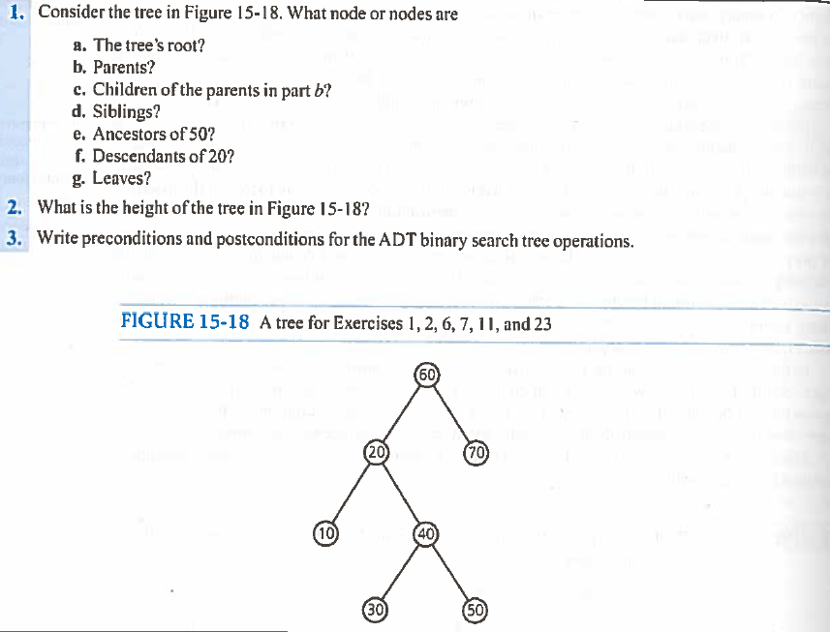
Questions

Slide 45
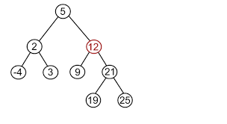
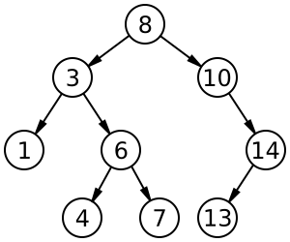
Questions
Provide the breadth first, in-order, pre-order and post order traversal for these trees
Given a binary tree, provide the pseudo-code to check whether it’s a binary search tree or no
Two nodes are said to be cousins of each other if they are at same level of the Binary Tree and have different parents Given a binary Tree and the two nodes say ‘p’ and ‘q’, provide the pseudo-code to determine whether the two nodes are cousins of each other or not.
Notes:
1) Two binary trees are considered equal if they are structurally identical and the nodes have the same value. Run a search on both and see if have same values at each step
2) Wrong approach - assume that the current node’s value is k. Then for each node, check if the left node’s value is less than k and the right node’s value is greater than k. If all of the nodes satisfy this property, then it is a BST.
Right approach – assume that the current node’s value is k. Then for each node, check if all nodes of left subtree contain values that are less than k. Also check if all nodes of right subtree contain values that are greater than k. If all of the nodes satisfy this property, then it must be a BST.
Right approach – use ranges. In a BST, the root is greater than all nodes of the left sub tree. So root value forms an upper bound on left sub tree values. Similarly, since the root is less than all the nodes of the right sub tree, root value forms a lower bound on the right sub tree values. This can be used for checking if a binary tree is a binary search tree or not. 1. Initialize, low = MAX_VALUE, high = MIN_VALUE. 2. If root.data <= low || root.data >= high, return false. 3. Recursively check for left sub tree and right sub tree. a. For left sub tree, pass high as root.data because for a BST, root forms an upper bound for left sub tree node values. b. For right sub tree, pass low as root.data because for a BST, root forms a lower bound for right sub tree node values. Time complexity: O(n)
Right approach – Do In-Order Traversal of the given tree and store the result in a temp array. Check if the temp array is sorted in ascending order, if it is, then the tree is BST. This method also runs in O(N) time and O(1) space.
3) Check the height of both the nodes, if heights are dif­fer­ent then return false.
Check if both the nodes have the same par­ent, if yes then return false.
else return true.

Slide 46
Checking for Equal Binary Trees
Given two binary trees, how do you check if they are equal or not i.e. they are structurally identical and all nodes have the same value
Def EqT(T1, T2):
if (T1= empty and T2 = empty):
return True
if (T1 != empty or T2 != empty):
return False
if (root (T1) = root (T2) and EqT(left(T1), left(T2)) and EqT(right(T1), right(T2))):
return True
return False
Complexity is O(N), where N is number of nodes in a tree

Slide 47
Questions
Construct a Binary search tree and print the in-order traversal for the following pre-order traversal
7 3 1 0 2 5 4 6 9 8 10
Given a sorted array, describe a program to create a balanced BST from the sorted array
Notes:
Answer: 0 1 2 3 4 5 6 7 8 9 10
Answer We know that the in-order traversal of binary search tree gives the elements in sorted order. This tells us that the middle element of array will be the root. We can create left and right subtree by recursively calling same function for left and right subarray.

Slide 48
Exercises
Beginning with an empty binary search tree, what binary search tree would be formed when you insert the following values in the order given
6, 5, 11, 1, 4, 7, 2
W, T, N, J, E, B, A
W, T, N, A, B, E, J
A, B, W, J, N, T, E
B, T, E, A, N, W, J

Slide 49
3. Heap
Notes:
To create Em dash above headline:
Same size and weight as the headline and set using a soft return.
PC: Em dash (—): Alt+Ctrl+ - (minus)
Mac: Em dash (—): Shift+Alt/Option+hyphen

Slide 50
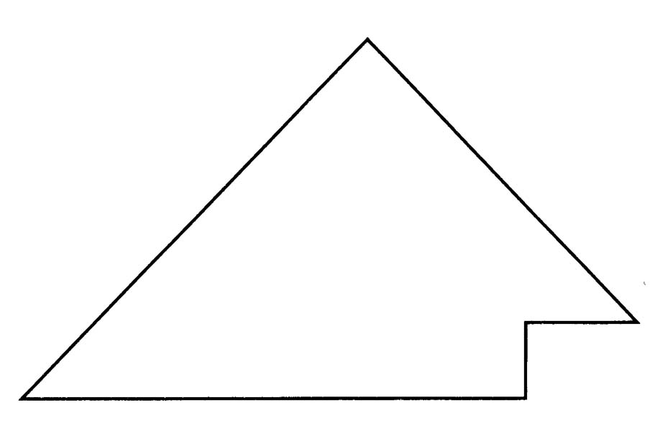
Complete Binary Tree
A binary tree that is either full or full through the next-to-last level
The last level is full from left to right - i.e., leaves are as far to the left as possible
Complete Binary Tree

Slide 51
A Heap
A heap is a binary tree that satisfies these special SHAPE and ORDER properties:
Its shape must be a complete binary tree
For each node in the heap, the value stored in that node is greater than or equal to the value in each of its children
Has heaps as subtrees
A heap is similar to a BST but differs in two ways
A BST is sorted, a heap is sorted in a much “weaker” sense
A BST comes in many different shapes, a heap is always a complete binary tree

Slide 52
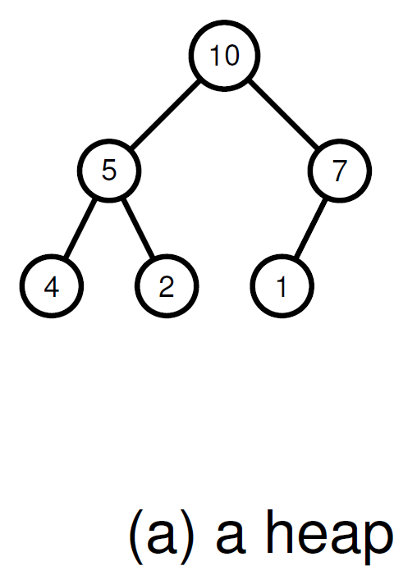
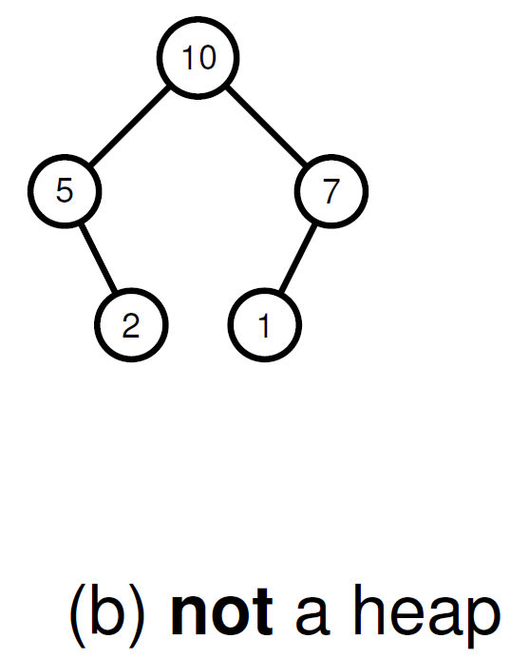
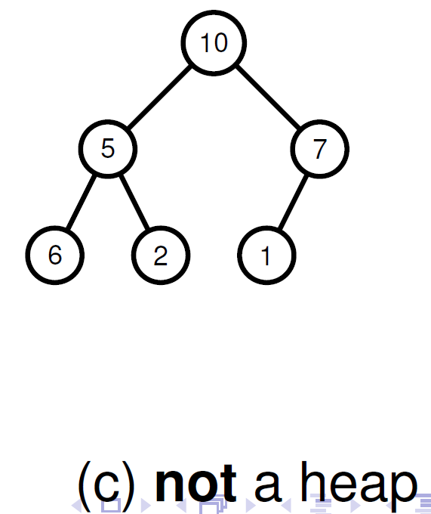
Heaps

Slide 53
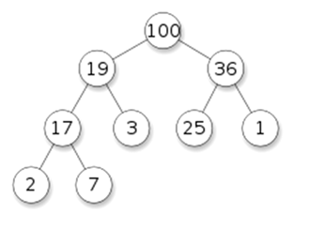
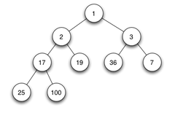
Max and Min Heap
heap-order property → maintaining this property (i.e., heapify) takes O(log n)
Max heap: in every subtree, root holds the largest value → access maximum in constant time | Min heap: in every subtree, root holds the smallest value → access minimum in constant time

Slide 54
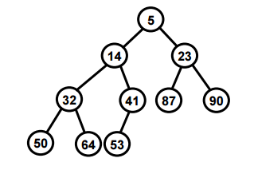
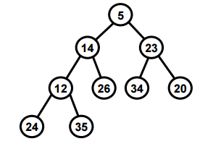
Which of these are Min Heaps
Tree A
Tree B

Slide 55
Heaps – Applications
Efficient data structure for several important applications, including:
Implement priority queues
Finding max/min in an array of elements
Fast implementations of graph algorithms like Prim’s algorithm
Implement heapsort

Slide 56
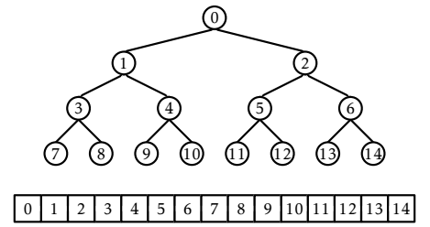
Heap Representation
Eytzinger’s method: embed a complete binary tree into an array
→ lays out the nodes in breadth-first order (top down, layer by layer, left to right)
Left child of the node at index i is at index left(i) = 2i + 1
Right child of the node at index i is at index right(i) = 2i + 2
Parent of the node at index i is at index parent(i) = (i−1)/2
Notes:
Left(3) = 2*3 + 1 = 7

Slide 57
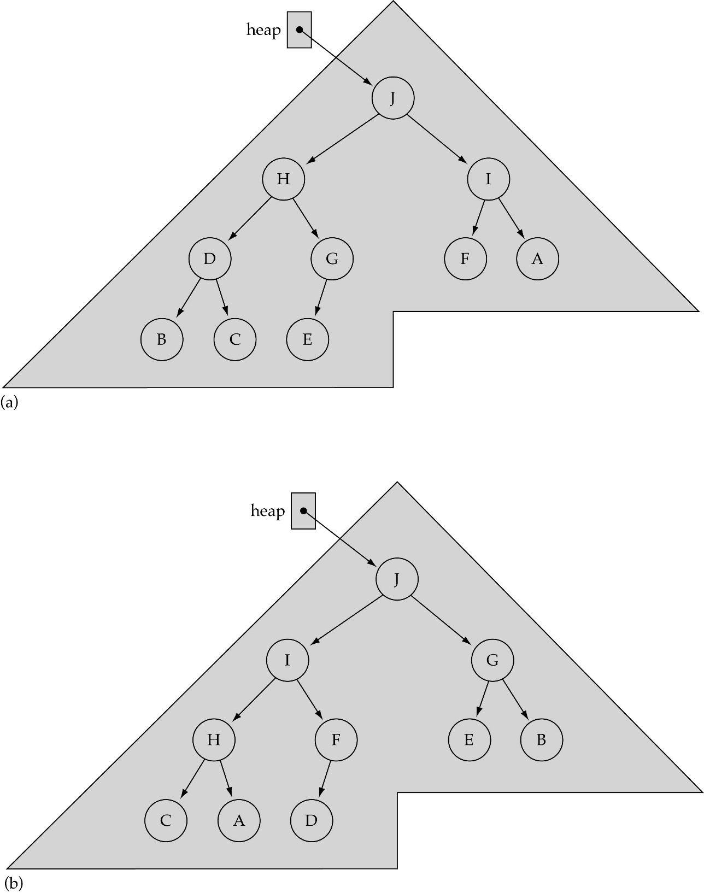
Heap Non-uniqueness

Slide 58
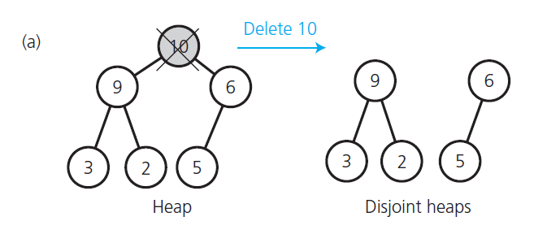
Removing the Heap’s Root
Removing the heap’s root creates 2 disjoint heaps
How can you combine these two heaps and make a new heap

Slide 59
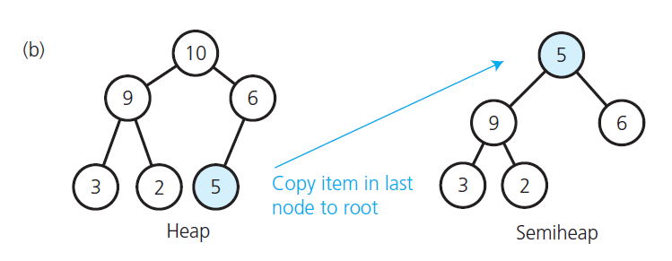
Creating a Semi-heap
Deleting the root will create two heaps. Taking the last item and copying it to the root creates a semi-heap – i.e. a heap that only the root is out of place

Slide 60
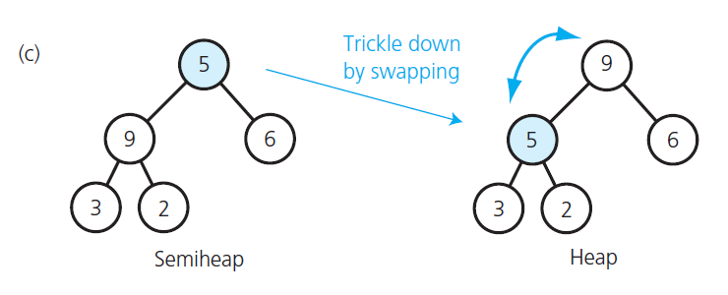
Rebuilding the Heap
To rebuild the semi-heap, swap the root with its largest child and repeat until the node is bigger than both its children

Slide 61
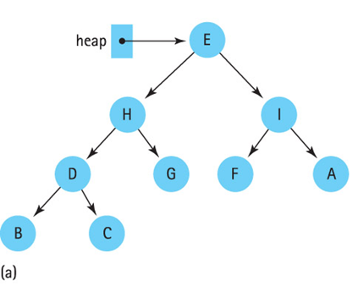
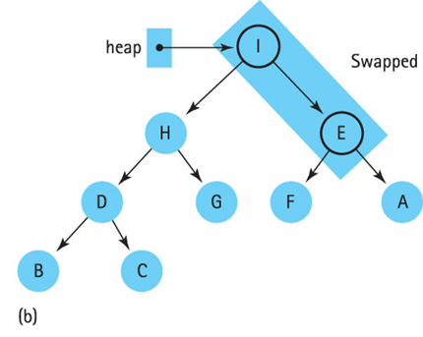
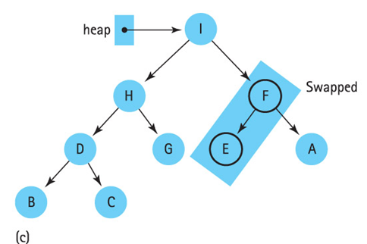
Rebuilding the Heap
To rebuild the semi-heap, swap the root with its largest child and repeat until the node is bigger than both its children

Slide 62
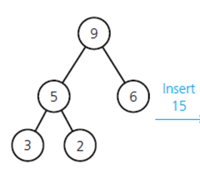
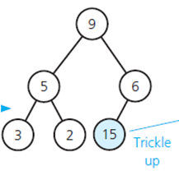
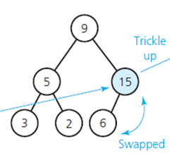
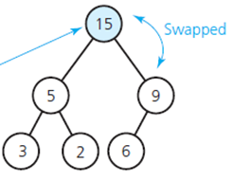
Inserting into a Heap
Insertion into a heap is the opposite of remove. The new item is inserted into the bottom and then trickles up
Recall that the parent of items[i] is stored in items[(i-1)/2]

Slide 63
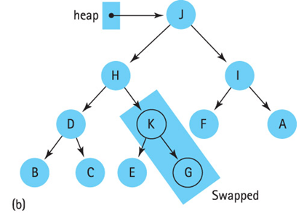
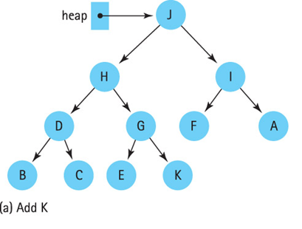
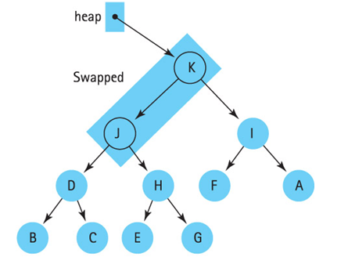
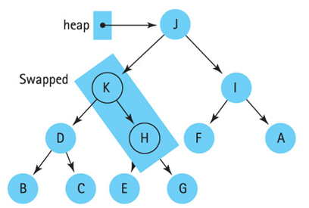
Inserting into a Heap
bottom

Slide 64
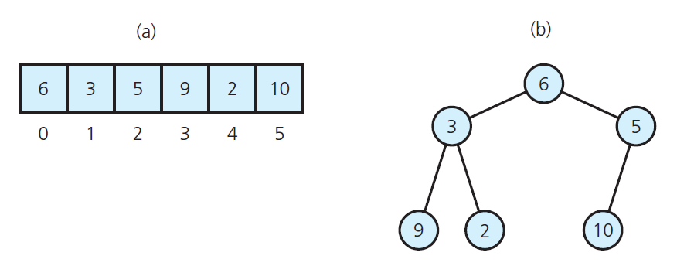
An Array and its Binary Tree
How can we convert the Binary Tree into a Max Heap?
The initial contents of an array;
The array’s corresponding complete binary tree

Slide 65
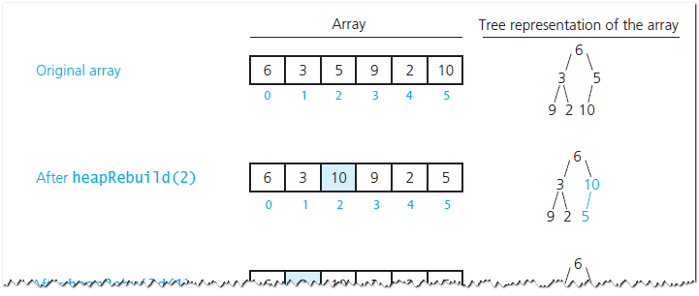
Array to Max Heap Conversion
Done by going through the array that represents the heap from the end to the beginning, looking for an element that is smaller than its child, and then swapping with the biggest child recursively

Slide 66
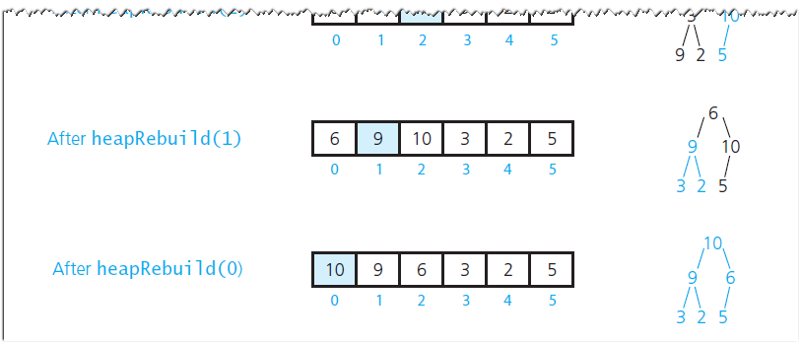
Array to Heap Conversion

Slide 67
Array to Max Heap Conversion
4 | 1 | 3 | 2 | 16 | 9 | 10 | 14 | 8 | 7
i = 4
0
i = 3
0
i = 2
0
4
4
4
1
2
1
2
1
2
1
3
1
3
1
3
3
4
5
6
3
4
5
6
3
4
5
6
2
16
9
10
2
16
9
10
14
16
9
10
7
8
9
7
8
9
7
8
9
14
8
7
14
8
7
2
8
7
0
0
0
i = 1
4
i = 0
4
16
1
2
1
2
1
2
1
10
16
10
14
10
3
4
5
6
3
4
5
6
3
4
5
6
14
16
9
3
14
7
9
3
8
7
9
3
7
8
9
7
8
9
7
8
9
2
8
7
2
8
1
2
4
1

Slide 68

Heap Construction - Analysis
The height of the heap is h = logn
Each call to repair takes O(logn) time.
There are n/2 $∈$O(n) such calls.
Therefore, O(n logn) is an upper bound on the running time of building the heap.

Slide 69
Questions
Question: In a binary max heap containing n numbers, the smallest element can be found in what time?
Question: In a binary max heap containing n numbers, the largest element can be found in what time?

Slide 70
Exercises
Which one of the following arrays represents a binary max-heap? Draw each of the 4 trees and indicate at least one node in three of the trees that stop it from being a max-heap
25, 12, 16, 13, 10, 8, 14
25, 14, 13, 16, 10, 8, 12
25, 14, 16, 13, 10, 8, 12
25, 14, 12, 13, 10, 8, 16

Slide 71
Exercises
Draw the max heap created from the array A = [6, 10, 1, 8, 7, 9, 3, 24, 11]. Show all steps without skipping any details.
Illustrate the operation of remove() from the max heap A = [15, 13, 9, 5, 12, 8, 7, 4, 0, 6, 2, 1]. Show all the steps without skipping any details.

Slide 72
4. Tree Algorithms
Notes:
To create Em dash above headline:
Same size and weight as the headline and set using a soft return.
PC: Em dash (—): Alt+Ctrl+ - (minus)
Mac: Em dash (—): Shift+Alt/Option+hyphen

Slide 73
Tree Algorithms
The tree structures provide many interesting and practical algorithms
Graph traversal
Data compression

Slide 74
4a. Graph Traversal
Notes:
To create Em dash above headline:
Same size and weight as the headline and set using a soft return.
PC: Em dash (—): Alt+Ctrl+ - (minus)
Mac: Em dash (—): Shift+Alt/Option+hyphen

Slide 75



Graph Search application(s)
How to find the shortest path in a road network?
How to find a path through a maze?
How to determine if a power network is connected?

Slide 76
Graph Search application(s)
Social networks
Crawling the web
Garbage collection
Solving puzzles
…

Slide 77

Introducing Graph Search algorithms
Depth-First Search (DFS)
Breadth-First Search (BFS)

Slide 78
Depth-First Search – Idea
Choose an arbitrary vertex and mark it visited.
From the current vertex, proceed to an unvisited, adjacent vertex and mark it visited.
Repeat 2nd step until a vertex is reached which has no adjacent, unvisited vertices (dead-end).
At each dead-end, backtrack to the last visited vertex and proceed down to the next unvisited, adjacent vertex.
The algorithm halts there are no unvisited vertices.

Slide 79
Depth-First Search – Demo
https://www.cs.usfca.edu/~galles/visualization/DFS.html

Slide 80

Depth-First Search – Pseudocode

Slide 81

Depth-First Search – Pseudocode

Slide 82
Depth-First Search – Implementation and Complexity
A DFS search can be implemented with graphs represented as:
Adjacency matrices with complexity = O(|V |²)
It is a graph traversal, so we need to iterate over all vertices (|V | of these).
For each vertex, we need to check the neighbours of it. For the matrix representation, the only way we can guarantee to find all neighbours of vertex i is to do a linear scan across its row in the matrix, which has |V | elements.
So |V | * |V | gives O(|V |²) complexity. The traversal also needs to setup visited status, which requires O|V | complexity, but the quadratic term dominates.

Slide 83
Breadth-First Search – Idea
Choose an arbitrary vertex v and mark it visited.
Visit and mark (visited) each of the adjacent(neighbour) vertices of v in turn.
Once all neighbours of v have been visited, select the first neighbour that was visited, and visit all its (unmarked) neighbours.
Then select the second visited neighbour of v, and visit all its unmarked neighbours.
The algorithm halts when we visited all vertices.

Slide 84
Breadth-First Search – Demo
https://www.cs.usfca.edu/~galles/visualization/BFS.html

Slide 85

DFS vs. BFS

Slide 86
4b. Data Compression
Notes:
To create Em dash above headline:
Same size and weight as the headline and set using a soft return.
PC: Em dash (—): Alt+Ctrl+ - (minus)
Mac: Em dash (—): Shift+Alt/Option+hyphen

Slide 87

What is data compression?
Data compression is the process of representing a data source in a reduced form. If there is no loss of information, it is called lossless compression.
The three principle components of a compression system: modelling, probability
estimation, and coding.

Slide 88


Fixed Length Codes
The simplest encoding/decoding approach is to create a mapping from source alphabet to strings (codewords), where these codewords are fixed in length.
Example: Give $S=\left\{a,c,g,t\right\}, Σ=\{0,1\}$, and the encoding scheme,
then $φ\left(gattaca\right)=10001111000100.$
$$a⟼00,$$
$$c⟼01,$$
$$g⟼10,$$
$$t⟼11$$

Slide 89

Fixed Length Codes – ASCII
ASCII – American Standard Code for Information Interchange is a fixed length character encoding scheme over an alphabet of 128 characters.

Slide 90

Fixed Length Codes – ASCII
$$char∗ string = “AARDVARK”$$
A | A | R | D | V | A | R | K
0x41 | 0x41 | 0x52 | 0x44 | 0x56 | 0x41 | 0x52 | 0x4B
1000001 | 1000001 | 1010010 | 1000100 | 1010110 | 1000001 | 1010010 | 1001011

Slide 91
Fixed Length Codes
Fixed length codewords are not the optimal in average bits per source symbol.
Why? The frequency of appearance of each member of the source alphabet may not be uniformly distributed.
Consider the letters ‘e’ and ‘z’ in natural language text, and using the same length codewords to represent both.
e.g., “zee”
Using ASCII where each letter represented by 7 bits, this is 3 * 7 = 21 bits

Slide 92
Character Frequency
Character | Frequency | Probability
e | 24,600,752 | 0.0880
t | 18,443,242 | 0.0660
a | 17,379,446 | 0.0621
… | … | …
j | 671,765 | 0.0024
q | 264,712 | 0.0009
z | 186,802 | 0.0007
The frequency of appearance of characters from the English alphabet extracted from a 267MB segment of SGML-tagged (Standard Generalized Markup Language) newspaper text drawn from the WSJ component of the TREC data set.

Slide 93
Variable Length Codes
Solution?
A variable length code maps each member of a source alphabet to a codeword string, but the length of codewords is no longer fixed.
E.g., use a shorter codeword for ’e’ and a larger one for ’z’.
“zee” (hypothetically use 2 bit code for ’e’ and ’10’ bit code for z, this is 10 + 2*2 = 14 bits)
However, not all possible variable length coding schemes are decodable.

Slide 94

Variable Length Codes – Decoding
Symbol | A | B | C | D | E | F | G
Frequency | 25 | 12 | 9 | 4 | 3 | 2 | 1
Symbol | Codeword | $$ℓ_{i}$$
a | 0 | 1
b | 1 | 1
c | 00 | 2
d | 01 | 2
e | 10 | 2
f | 11 | 3
g | 110 | 3
Decode: 0010100010000111001011
Variable length codes must be chosen so text is uniquely decodable.

Slide 95

Variable Length Codes – Prefix Codes
Prefix Codes: Variable length codewords where no codeword is a prefix of any other codeword. Prefix codes are uniquely decodable.
Symbol | Codeword | $$ℓ_{i}$$
a | 0 | 1
b | 100 | 3
c | 110 | 3
d | 111 | 3
e | 1010 | 4

Slide 96
Huffman’s Code – Sketch
Huffman Algorithm generates prefix codes that are optimal in the average number of bits per symbol.
Idea: Build prefix tree bottom up. Read the codes from this prefix tree.

Slide 97
Huffman’s Code – Sketch
For each symbol, calculate the probability of appearance. Construct a leaf node for it.
Put these leaf nodes to the set of candidate nodes (to merge).
Select the two nodes with the lowest probability (from candidate nodes) and combine them in a “bottom-up” tree construction.

Slide 98
Huffman’s Code – Sketch
The new parent has a probability equal to the sum of the two child probabilities, and replaces the two children in the set of candidate nodes. Add links to the children, one link with labelled ’0’, the other ’1’.
When only one candidate node remains, a tree has been formed, and codewords can be read from the edge labels of a tree.

Slide 99


Huffman Trees – Example
Construct a Huffman Tree from the Alphabet
$$\{\left(a,0.05\right),\left(b,0.05\right),\left(c,0.1\right),\left(d,0.2\right),\left(e,0.3\right),\left(f,0.2\right),\left(g,0.1\right)\}.$$

Slide 100

Huffman Trees – Example
Construct a Huffman Tree from the Alphabet
$$\{\left(a,0.05\right),\left(b,0.05\right),\left(c,0.1\right),\left(d,0.2\right),\left(e,0.3\right),\left(f,0.2\right),\left(g,0.1\right)\}.$$

Slide 101

Huffman Trees – Example
Construct a Huffman Tree from the Alphabet
$$\{\left(a,0.05\right),\left(b,0.05\right),\left(c,0.1\right),\left(d,0.2\right),\left(e,0.3\right),\left(f,0.2\right),\left(g,0.1\right)\}.$$

Slide 102

Huffman Trees – Example
Construct a Huffman Tree from the Alphabet
$$\{\left(a,0.05\right),\left(b,0.05\right),\left(c,0.1\right),\left(d,0.2\right),\left(e,0.3\right),\left(f,0.2\right),\left(g,0.1\right)\}.$$

Slide 103

Huffman Trees – Example
Construct a Huffman Tree from the Alphabet
$$\{\left(a,0.05\right),\left(b,0.05\right),\left(c,0.1\right),\left(d,0.2\right),\left(e,0.3\right),\left(f,0.2\right),\left(g,0.1\right)\}.$$

Slide 104

Huffman Trees – Example
Construct a Huffman Tree from the Alphabet
$$\{\left(a,0.05\right),\left(b,0.05\right),\left(c,0.1\right),\left(d,0.2\right),\left(e,0.3\right),\left(f,0.2\right),\left(g,0.1\right)\}.$$

Slide 105

Huffman Trees – Example
Construct a Huffman Tree from the Alphabet
$$\{\left(a,0.05\right),\left(b,0.05\right),\left(c,0.1\right),\left(d,0.2\right),\left(e,0.3\right),\left(f,0.2\right),\left(g,0.1\right)\}.$$

Slide 106

Huffman Codes
Symbol | Codeword | $$ℓ_{i}$$
a | 0000 | 4
b | 0001 | 4
c | 001 | 3
d | 01 | 2
e | 10 | 2
f | 110 | 3
g | 111 | 3
The Huffman Codes and the corresponding codeword lengths.

Slide 107

Huffman Codes
This approach requires $Θ(n\log{n})$ time if a min heap (priority queue) is used to manage the set of candidates and their weights.
If the input list is already sorted by their probabilities, then the codes can be constructed in $Θ(n)$ time.
Notes:
Using a heap to store the weight of each tree, each iteration requires O(logn) time to determine the cheapest weight and insert the new weight, then heapify the queue each time. There are O(n) iterations, one for each item.

Slide 108
Huffman Algorithm – Demo
https://people.ok.ubc.ca/ylucet/DS/Huffman.html
http://huffman.ooz.ie/

Slide 109
To finish…

Slide 110
Learning Objectives
Understand and define various tree structures
Understand and implement various algorithms with the tree structures

Slide 112
Question
Consider an array representation of an n element binary heap where the elements are stored from index 1 to index n of the array. For the element stored at index i of the array (i <= n), the index of the parent is
i – 1
Floor(i/2)
Ceiling(i/2)
(i+1)/2
Notes:
Note that the parent of items[i] is stored in items[(i-1)/2]

Slide 113

Questions
Does the following array represent a binary max-heap?
25, 12, 16, 13, 10, 8, 14
Which of the following is a maxheap

Slide 114
Assignment 5
Does the array [30, 20, 50, 10, 25, 40, 60] represent a heap?
What complete binary tree does the array [5, 1, 2, 8, 6, 10, 3, 9, 4, 7] represent
Does the array in 2) represent a heap?
Draw the max heap created from the array [10,9,6,3,2,5]
Draw the max heap in 4), after you insert 12 and remove 12

Slide 115
Assignment 5
Draw the max heap created by - add(2), add(3), add(4), add(1), add(9), remove(), add(7), add(6), remove(), add(5)
Is the heap created from the array [30,20,50,10,25,40,60] a semi-heap?
Draw the min heap created from the array [4,7,9,10,12,13,11]
Draw the heap in 6) after you add(8), add(5), remove()
Sort the following array using heapsort – [5, 3, 1, 9, 8, 2, 4, 7]

